Slide 1
EPS Tech Roadmap UPDATE
21 October, 2015

Slide 2


Value-Managed Technology
Develop technologies to meet future customers and business needs
Ensure technology for future market growth and strength
All EPS Engineering projects managed and tracked in Technology Roadmap
Weekly meetings with cross functional group
Projects assessed and prioritized based on overall value
High risk projects reviewed weekly, others based upon scheduled cadence
Responsive development process
Project requirements defined for each project – exit criteria and timing

Slide 3
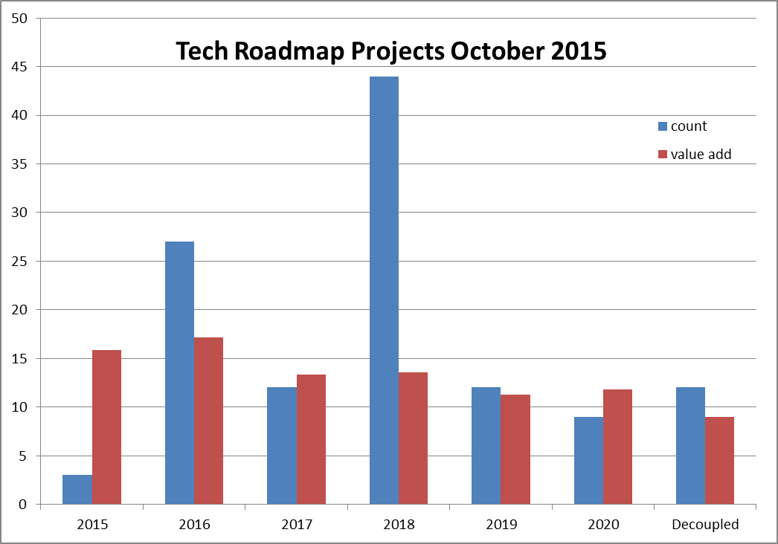
Value-Managed Technology
Value rating scale considers trade offs between attributes
120 Total Active Projects
13.5% Value Improvement average over current state
Value Attributes
Cost
Mass
Packaging
Performance
Quality
Value Stream/Risk Reduction
Developmental Efficiency
Growth Opportunity

Slide 4
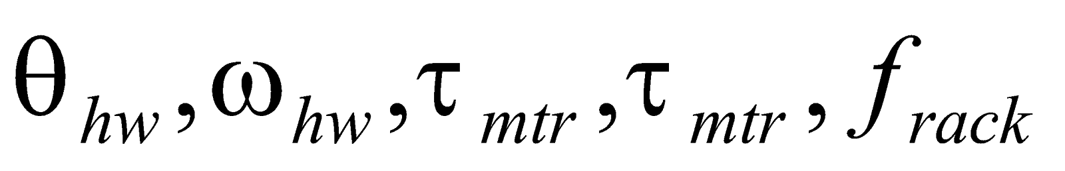

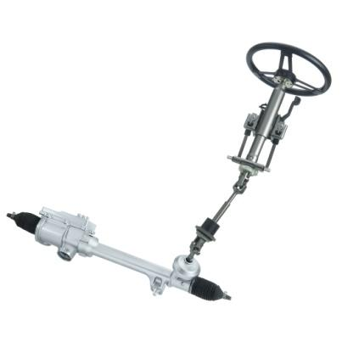
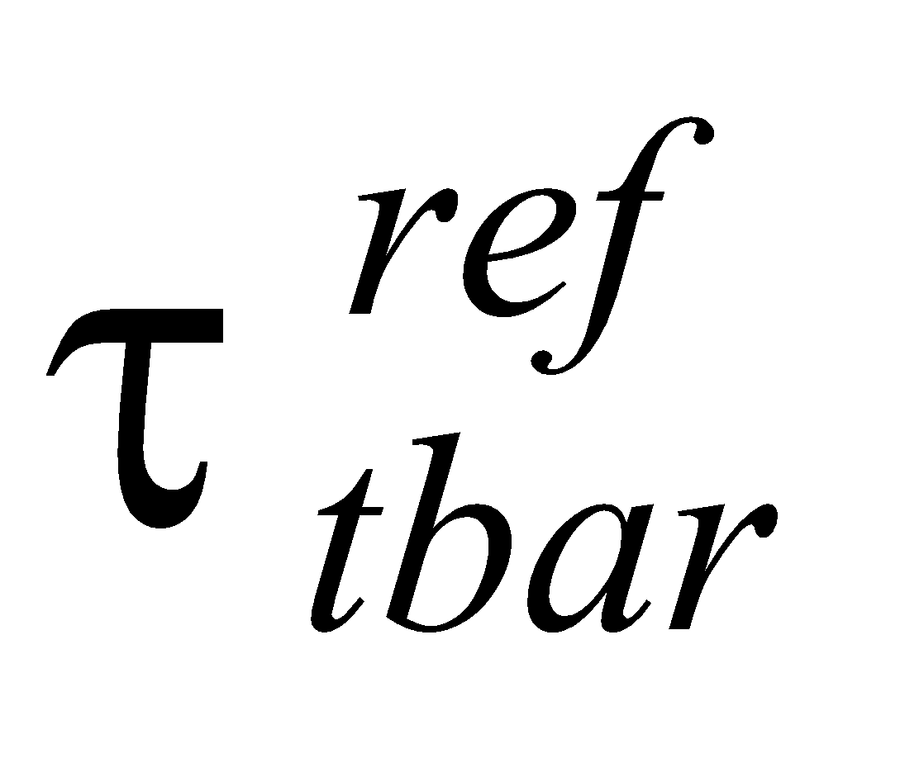






Key Project Drivers
Market Trends
71 projects positively impact our marketability
Steering Feel Configurator
Torque Feedback Controller
Current Controller
Automated Driving Support – 3 projects
Advanced Steering Features – 13 projects
Enhanced Safety Systems – 12 Projects

Slide 5

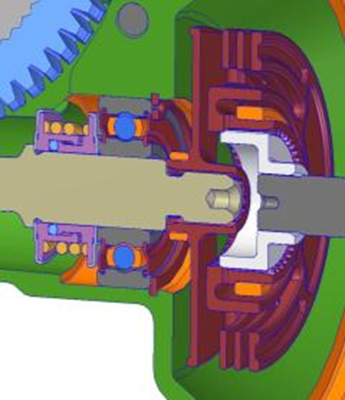
Key Project Drivers
Packaging
29 projects positively impact our packaging
Skewed worm axis
Overlapping coupler
Front mount MSB
Compact brush motor
Remote controller
Remove isolation on worm axis
Mass
28 projects reduce system Mass
Plastic housing
Plastic pulleys
Hollow rack
High ratio CEPS

Slide 6

Key Project Drivers
Cost Improvement
48 projects positively impact our marketability
New Electrical Architecture
Support AutoSar 4 and ISO 26262
Plastic components
Synchronous reluctance motor
Power inverter optimization
Motor optimization

Slide 7
Backup Material

Slide 8
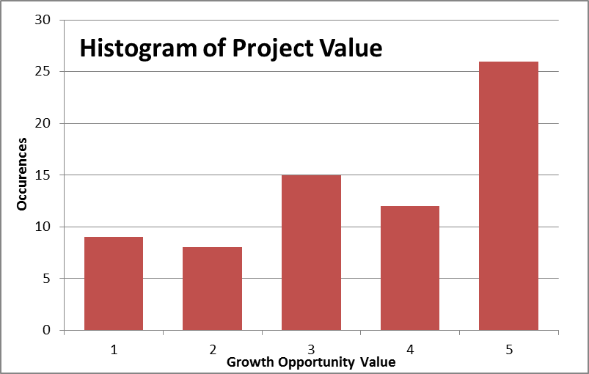
Key Project Drivers (rev 1)
Market Trends
71 projects positively impact our marketability
Average value add of those projects is 70% improvement
Automated Driving Support – 3 projects
Advanced Steering Features – 13 projects
Enhanced Safety Systems – 12 Projects

Slide 9
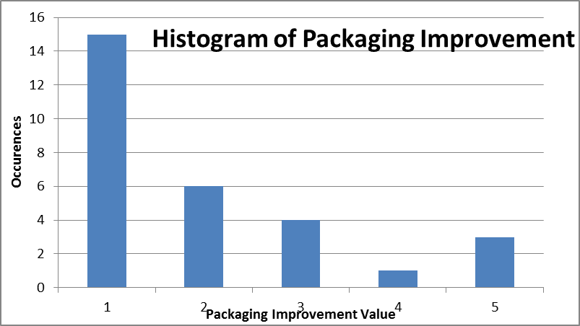
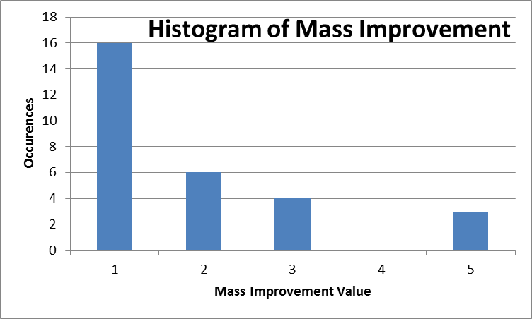
Key Project Drivers (rev 1)
Packaging
29 projects positively impact our packaging
Average value add of those projects is 40% enhancement
Mass
28 projects reduce system Mass
Average value add of those projects is 36% enhancement

Slide 10
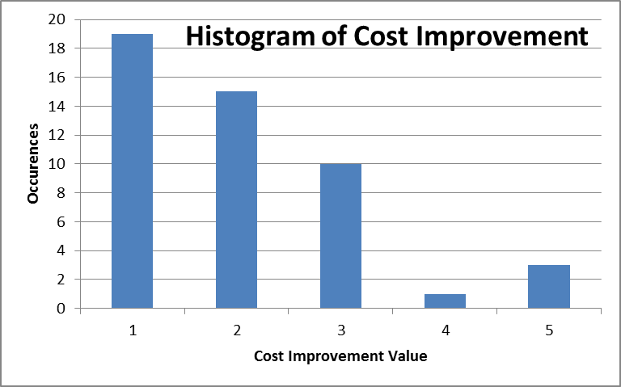
Key Project Drivers (rev 1)
Cost Improvement
48 projects positively impact our marketability
Average value add of those projects is 38% improvement

